Slide 1


Hafiz Putra Amanta
December 21, 2023

Slide 2

Outline
Executive Summary
Introduction
Methodology
Results
Conclusion
Appendix

Slide 3
Executive Summary
Summary of methodologies
Analisis dilakukan dengan tujuan untuk memprediksi first stage landing dari Space X Falcon 9. Data yang digunakan bersumber dari API yang disediakan oleh Space X secara publik. Proses data cleansing dan preprocessing dilakukan sebelum memilih model klasifikasi yang akan digunakan. Evaluasi terhadap model dilakukan berdasarkan skor dari parameter terbaik. Setiap model klasifikasi memberikan hasil yang sama pada data test, tetapi tree_cv memberikan hasil yang lebih baik pada data train, sehingga saya menyimpulkan bahwa model terbaik adalah tree_cv. Hasil prediksi menunjukkan bahwa
Summary of all results

Slide 4
Introduction
Space flight is a very expensive project. Various companies provide space flight services at varying costs. One company that offers low-cost space flights is Space X. The Falcon 9 owned by Space X is claimed to cost USD 62 million, compared to other companies, which usually cost up to USD 165 million. This cheaper cost can occur because SpaceX can reuse the first stage of its rocket. The ability to predict the success of the Falcon 9's first-stage landing can make it easier for companies to predict costs. In the end, if the costs incurred by Space X can be predicted, then Space Y can take a more precise policy regarding determining the price that will be offered in the project tender.
Seeing the importance of predicting the success of the Falcon 9 landing, a model is needed that can make predictions regarding this matter accurately.

Slide 5

Section 1

Slide 6
Methodology
Executive Summary
Data collection methodology:
Data is collected from the API provided by Space X as well as by webscraping from Wikipedia pages
Perform data wrangling
Data wrangling is carried out by doing Exploratory Data Analysis (EDA) to find patterns in the data and to determine data labels before preparing a predictive model.
Perform exploratory data analysis (EDA) using visualization and SQL
Perform interactive visual analytics using Folium and Plotly Dash
Perform predictive analysis using classification models
The selection of the classification model is carried out by considering the evaluation scores using training data and test data. The model with the highest score will be selected to predict the success of the Falcon 9's first stage landing

Slide 7
Data Collection
Describe how data sets were collected.
You need to present your data collection process use key phrases and flowcharts

Slide 8
Data Collection – SpaceX API
Present your data collection with SpaceX REST calls using key phrases and flowcharts
Add the GitHub URL of the completed SpaceX API calls notebook (must include completed code cell and outcome cell), as an external reference and peer-review purpose
Place your flowchart of SpaceX API calls here

Slide 9
Data Collection - Scraping
Present your web scraping process using key phrases and flowcharts
Add the GitHub URL of the completed web scraping notebook, as an external reference and peer-review purpose
Place your flowchart of web scraping here

Slide 10
Data Wrangling
Describe how data were processed
You need to present your data wrangling process using key phrases and flowcharts
Add the GitHub URL of your completed data wrangling related notebooks, as an external reference and peer-review purpose

Slide 11
EDA with Data Visualization
Summarize what charts were plotted and why you used those charts
Add the GitHub URL of your completed EDA with data visualization notebook, as an external reference and peer-review purpose

Slide 12
EDA with SQL
Using bullet point format, summarize the SQL queries you performed
Add the GitHub URL of your completed EDA with SQL notebook, as an external reference and peer-review purpose

Slide 13
Build an Interactive Map with Folium
Summarize what map objects such as markers, circles, lines, etc. you created and added to a folium map
Explain why you added those objects
Add the GitHub URL of your completed interactive map with Folium map, as an external reference and peer-review purpose

Slide 14
Build a Dashboard with Plotly Dash
Summarize what plots/graphs and interactions you have added to a dashboard
Explain why you added those plots and interactions
Add the GitHub URL of your completed Plotly Dash lab, as an external reference and peer-review purpose

Slide 15
Predictive Analysis (Classification)
Summarize how you built, evaluated, improved, and found the best performing classification model
You need present your model development process using key phrases and flowchart
Add the GitHub URL of your completed predictive analysis lab, as an external reference and peer-review purpose

Slide 16
Results
Exploratory data analysis results
Interactive analytics demo in screenshots
Predictive analysis results

Slide 17

Section 2

Slide 18
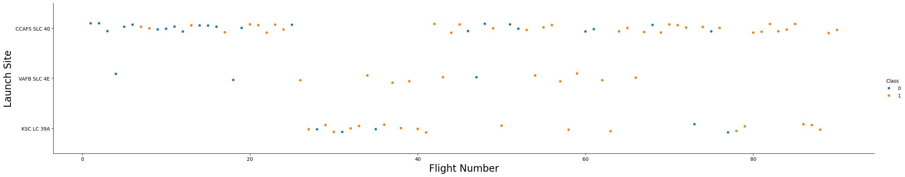
Flight Number vs. Launch Site

Slide 19
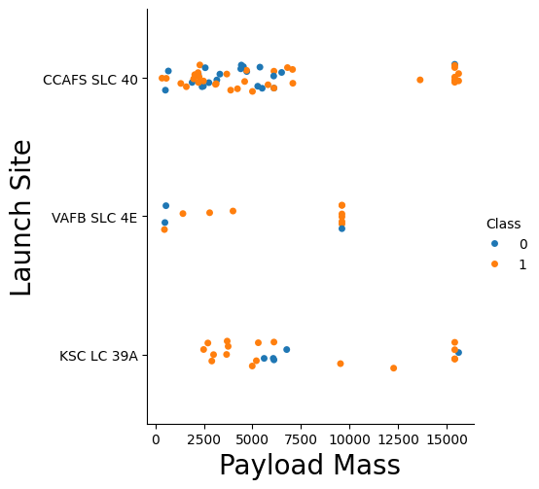
Payload vs. Launch Site

Slide 20
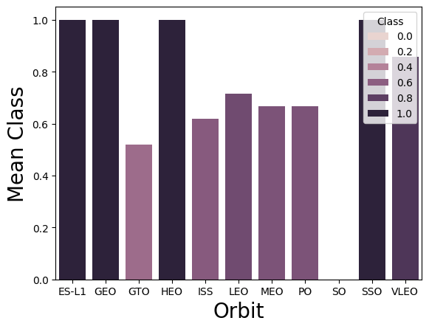
Success Rate vs. Orbit Type

Slide 21
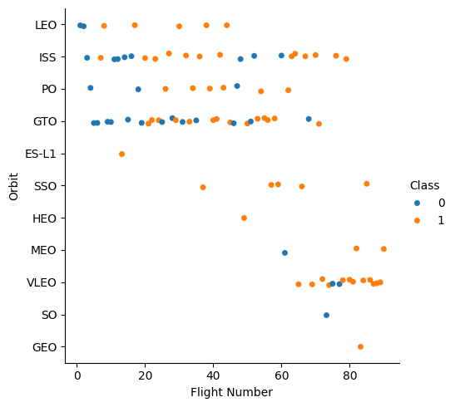
Flight Number vs. Orbit Type

Slide 22
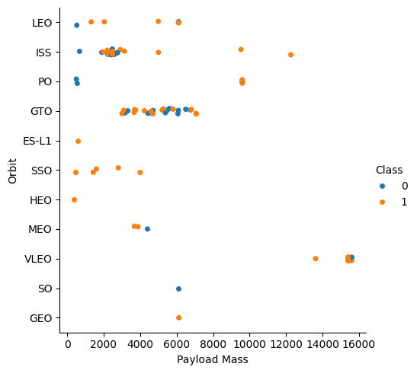
Payload vs. Orbit Type

Slide 23
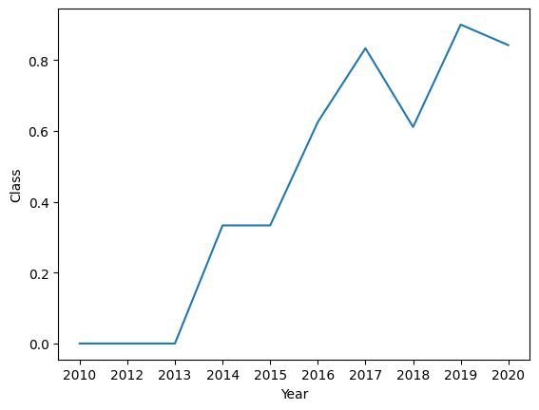
Launch Success Yearly Trend

Slide 24
All Launch Site Names
Launch_Site
CCAFS LC-40
VAFB SLC-4E
KSC LC-39A
CCAFS SLC-40

Slide 25
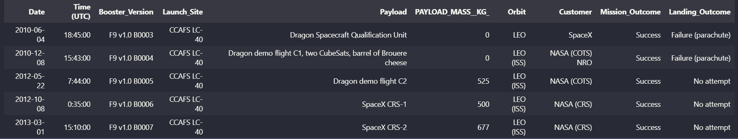
Launch Site Names Begin with 'CCA'

Slide 26
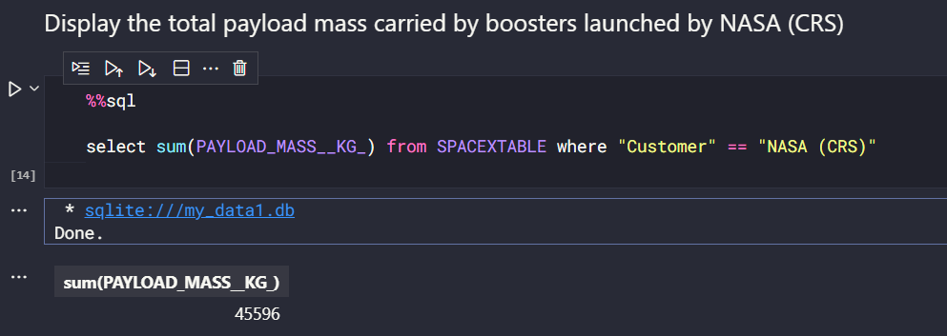
Total Payload Mass

Slide 27
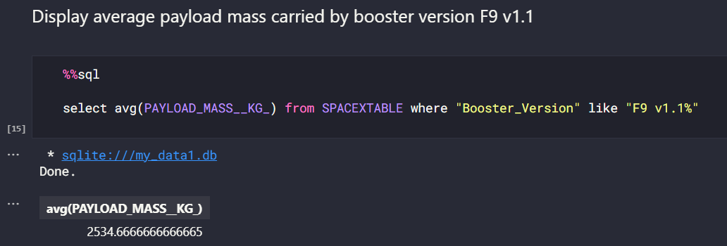
Average Payload Mass by F9 v1.1

Slide 28
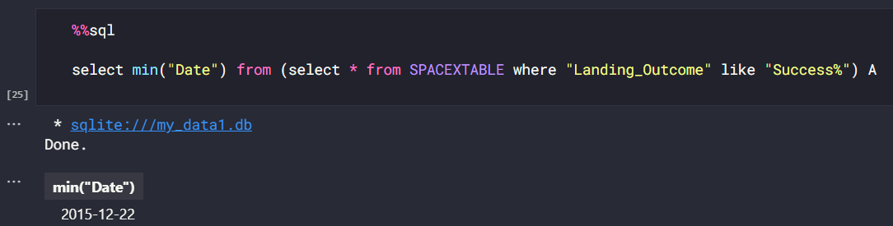
First Successful Ground Landing Date

Slide 29
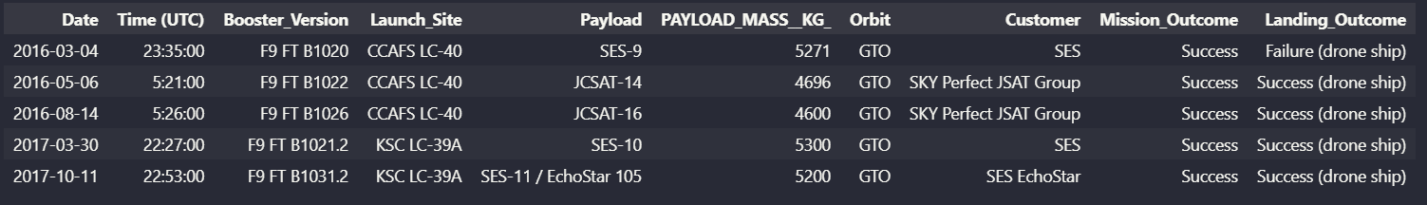
Successful Drone Ship Landing with Payload between 4000 and 6000

Slide 30
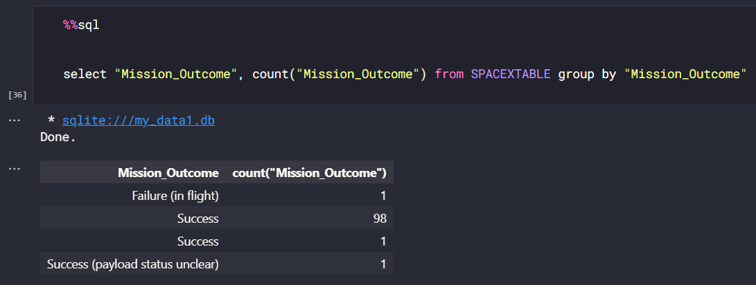
Total Number of Successful and Failure Mission Outcomes

Slide 31
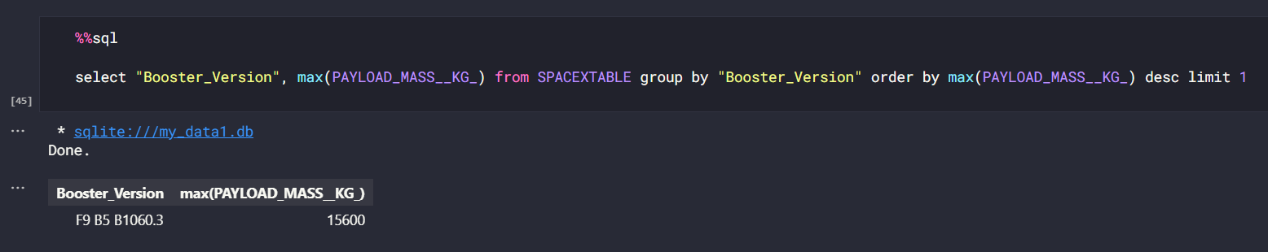
Boosters Carried Maximum Payload

Slide 32
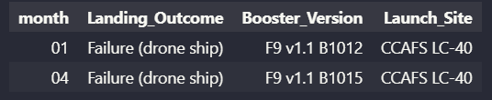
2015 Launch Records

Slide 33
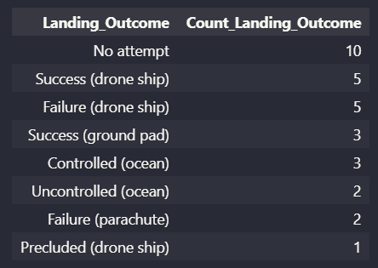
Rank Landing Outcomes Between 2010-06-04 and 2017-03-20

Slide 34

Section 3

Slide 35
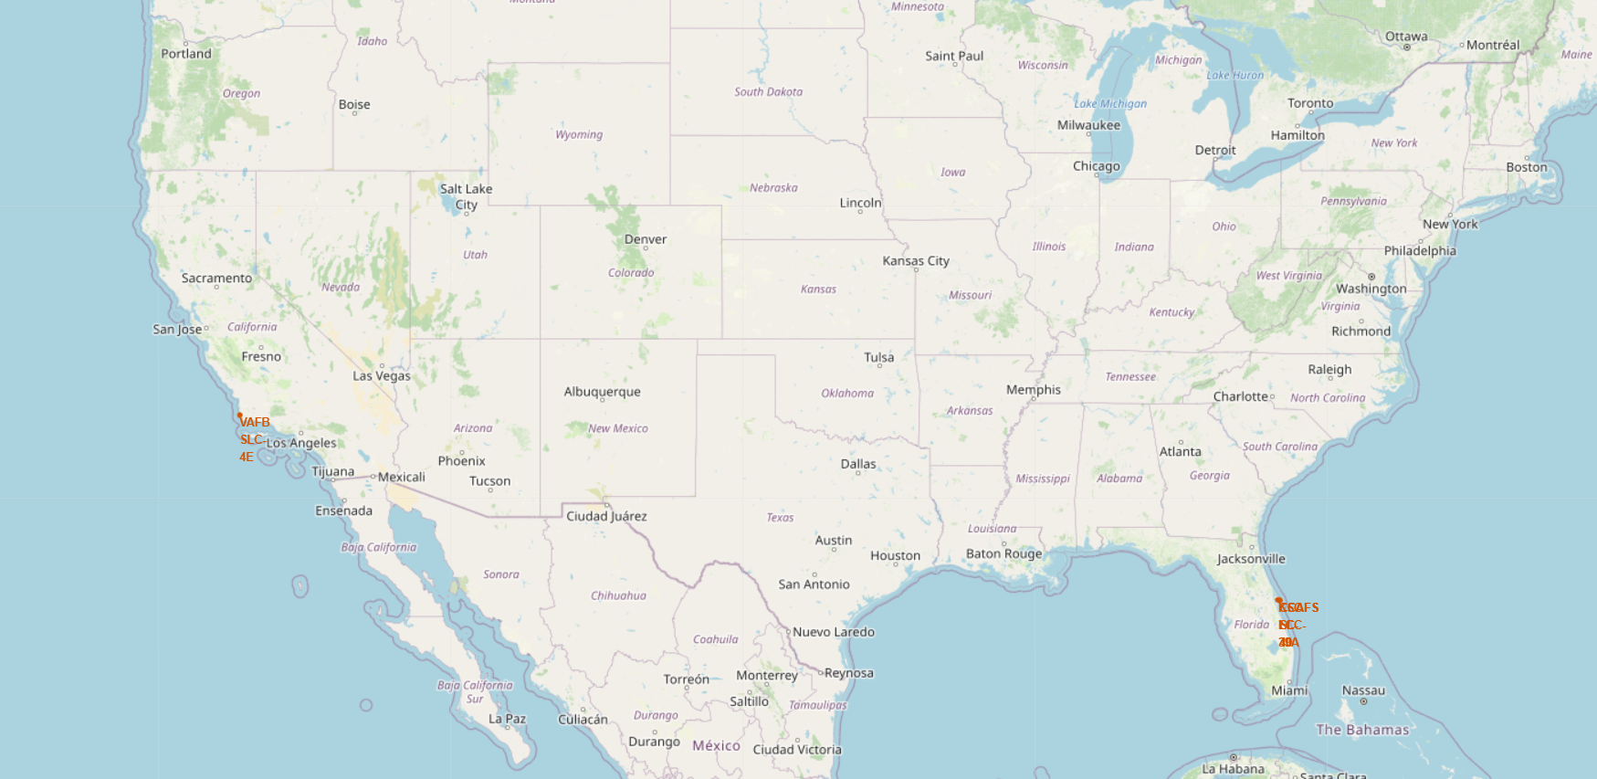
<Folium Map Screenshot 1>

Slide 36
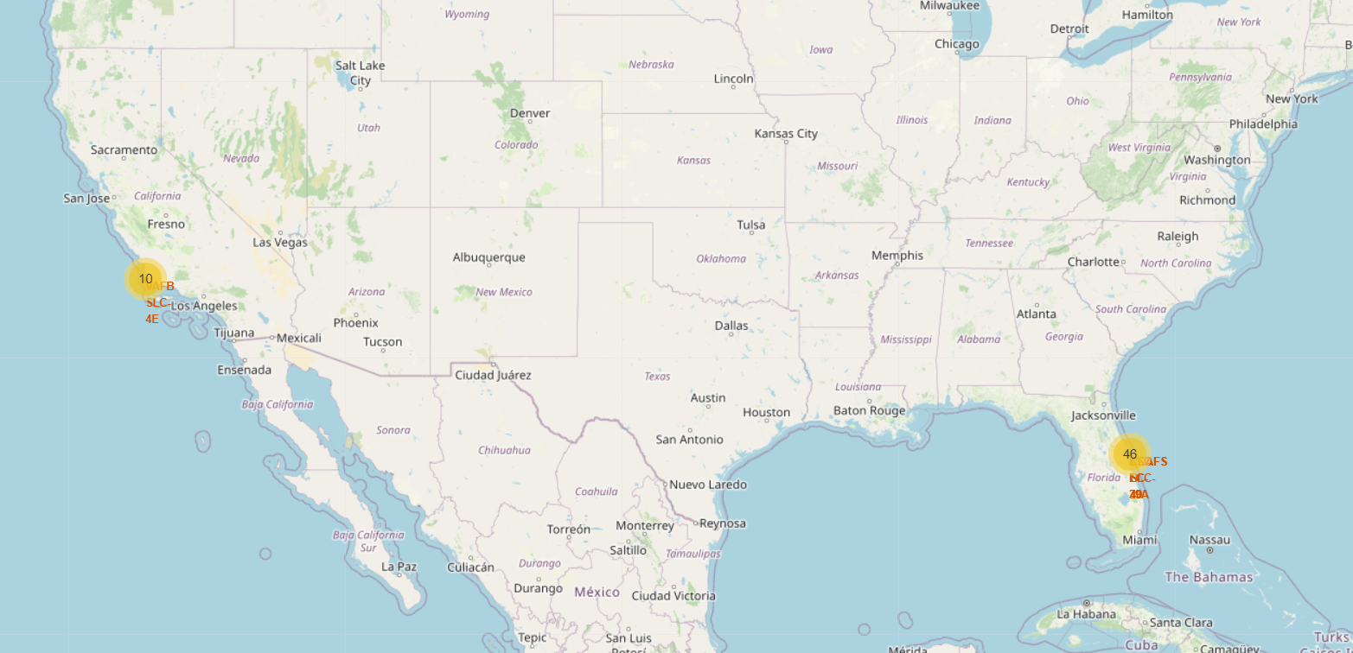
<Folium Map Screenshot 2>

Slide 37
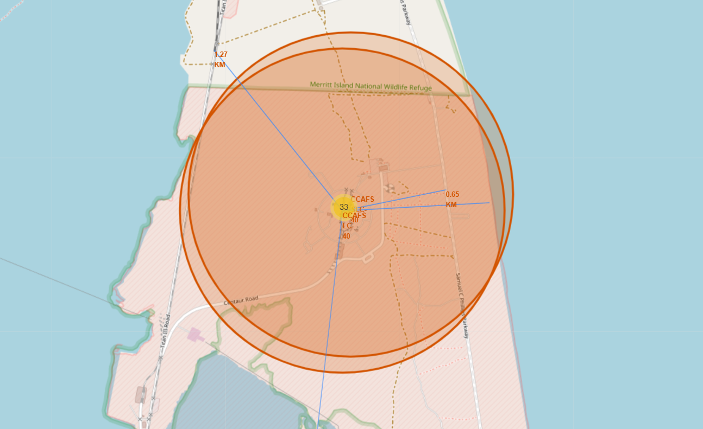
<Folium Map Screenshot 3>

Slide 38

Section 4

Slide 39
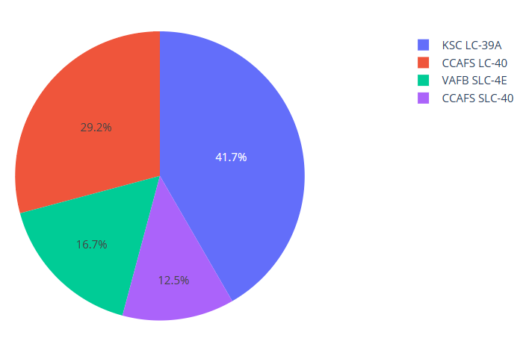
<Dashboard Screenshot 1>

Slide 40
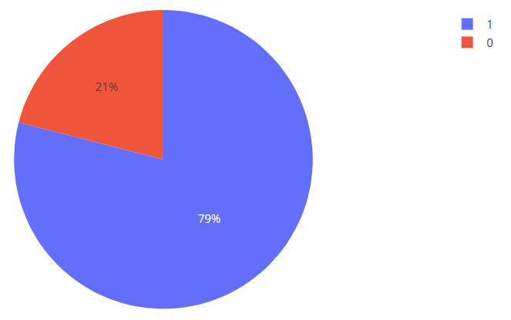
<Dashboard Screenshot 2>

Slide 41
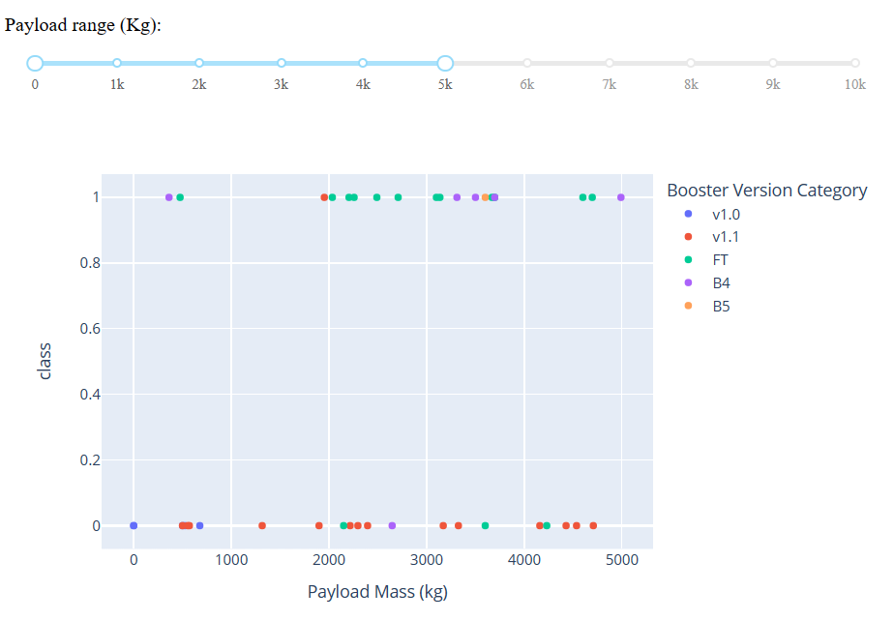
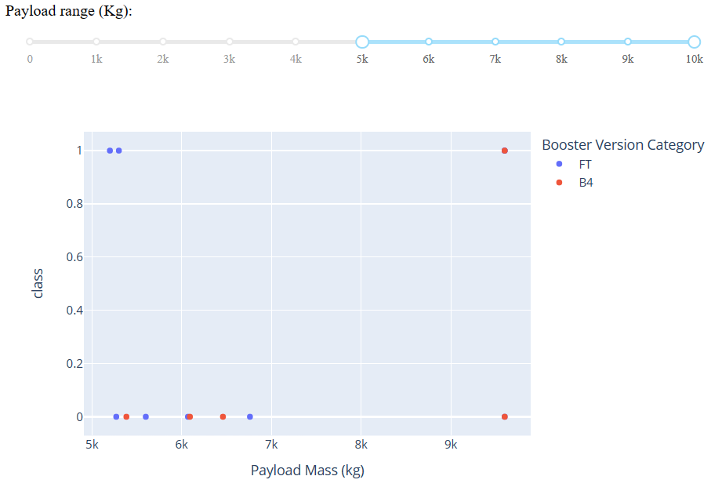
<Dashboard Screenshot 3>

Slide 42

Section 5

Slide 43
Classification Accuracy
Visualize the built model accuracy for all built classification models, in a bar chart
Find which model has the highest classification accuracy

Slide 44

Confusion Matrix

Slide 45
Conclusions
Point 1
Point 2
Point 3
Point 4
…

Slide 46
Appendix
Include any relevant assets like Python code snippets, SQL queries, charts, Notebook outputs, or data sets that you may have created during this project

Slide 47


